Slide 1
DeepGrasp
IMPLEMENTING DEEP LEARNING METHODS FOR NOVEL OBJECT GRASPING
Burak Mete
Advisor: Assoc. Prof. Dr. Sanem Sarıel
Spring 2019

Slide 2
Contents
Motivation
Literature Review
Project
Results
Conclusion
Future Research Topics
References

Slide 3
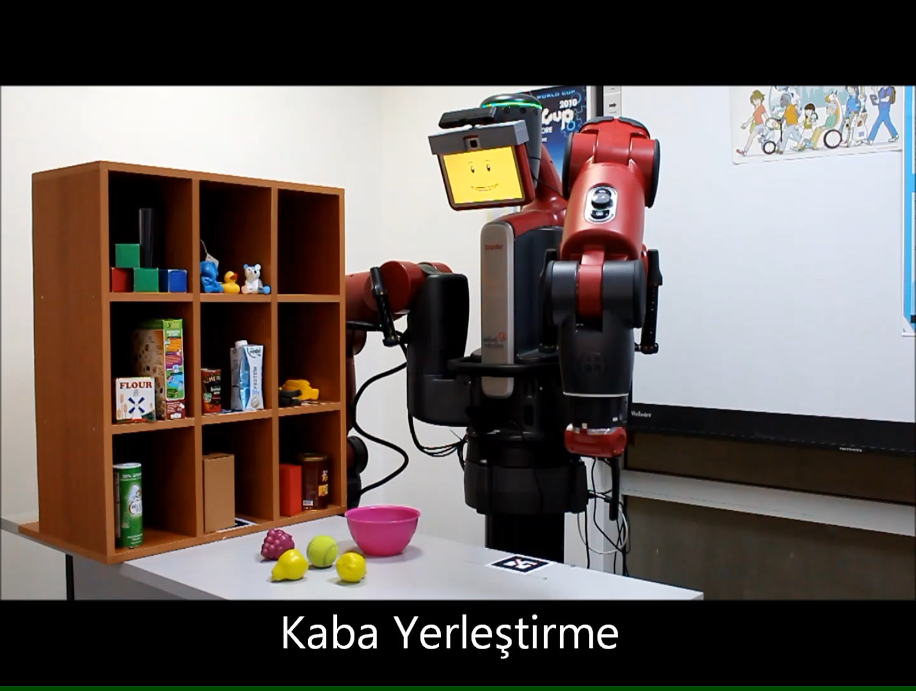
Motivation
We are trying to:
Make Robotic Grasping Subsystem fully automatized, relying only on the visual data
Being able to grasp novel objects with more precision
Introduce a better learning criteria than accustomed approaches
Notes:
1- A system should create a succesful grasping operation using only rgb image
2- Our system picks objects by object centroid/ Each object has its own unique picking position actually
3- How good is MSE?

Slide 4
Contents
Motivation
Literature Review
Project
Results
Conclusion
Future Research Topics
References

Slide 5
 | Data Retrieval | Input | Methodology | Output | Loss Function
Jiang et.al[1] | Syhntesis Data with human-labelling | RGB | Maps a score for each predefined patches. Rank patches | 3-DoF Grasping region (x,y, θ) | Patch Score Function
Pinto et.al[2] | Real time trial(Baxter) | RGB-D ROI patches | For each patch, classify the 18 different orientations. Select the best ROI+orientation | 3-DoF Grasping region (x,y, θ) | Cross Entropy
Saxena, A.[3] | Real-time trial (STAIR) | RGB | Maps a score for each pixel corresponding to its features. Rank pixels, select the best. | (x,y) Grasping Point | -
Lenz et.al[4] | Human labeling | RGB-D | Create candidate rectangles by exhaustive search. Classify the best among them | 5 DoF grasping rectangle parameter | -
Redmon et.al[5] | Human labeling | RGB-D | Classification ( Object Detection ) + Regression. ( Parameter Estimation ) | 5 DoF grasping rectangle parameter | Mean squared error over all possible positively annotated grasps.
DeepGrasp | Automatized Simulation Data | RGB | Regression of 5 parameters of grasping rectangle. Select the closest ground truth for loss, w.r.t IoU loss | 5 DoF grasping rectangle parameter | IoU Loss w.r.t nearest ground truth
Notes:
Learning Technique – Classification or Regression
Data Used
Learning Criteria
Different Drawbacks of the current methods.

Slide 6
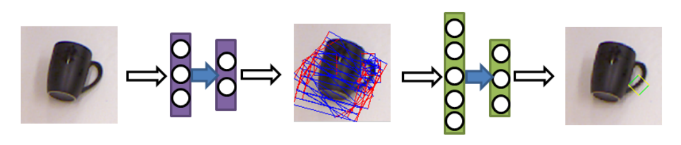
Lenz et.al. 2015[4]
A cascaded model to rank all candidate grasps, selecting the best among them.
Human labelled
Depends on trials for each object to decide fail or not
All grasping regions have the same size
Does not give any other grasping position other than what heuristics gave

Slide 7
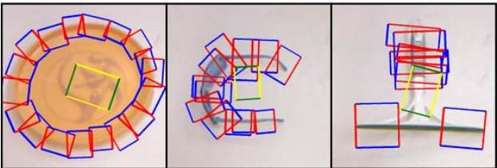
Redmon et.al. 2016[5]
Creates regression parameters for the object to be grasped
Uses MSE for the loss calculation.
Takes the average coordinates for multiple positive labels to calculate the loss
Figure 2- Fail scenarios for circular objects

Slide 8
Contents
Motivation
Literature Review
Project
Dataset
Methods
Results
Conclusion
Future Research Topics
References

Slide 9
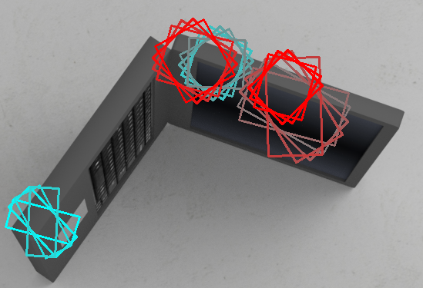
Datasets
Supervised Learning
10.000 Objects, 50.000 Images
All synthetically created.
Labelled through physics simulator pyBullet [5]
Avoid only finding human-alike grasps
Avoid time consume
50 positive annotations for each image
How to learn precisely, when there are numerous ground truth?
Select the closest ground truth by IoU loss, when calculating the loss.
Laptop object with ground truth values.
Similar colors represent resemblance grasps
Notes:
Some approaches take mean of all ground truth – fails on cylic shapes
Some approaches tries to learn all of them sequentially

Slide 10
Contents
Motivation
Literature Review
Project
Dataset
Methods
Results
Conclusion
Future Research Topics
References

Slide 11
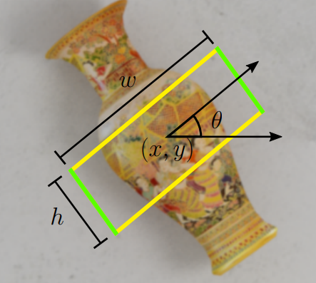
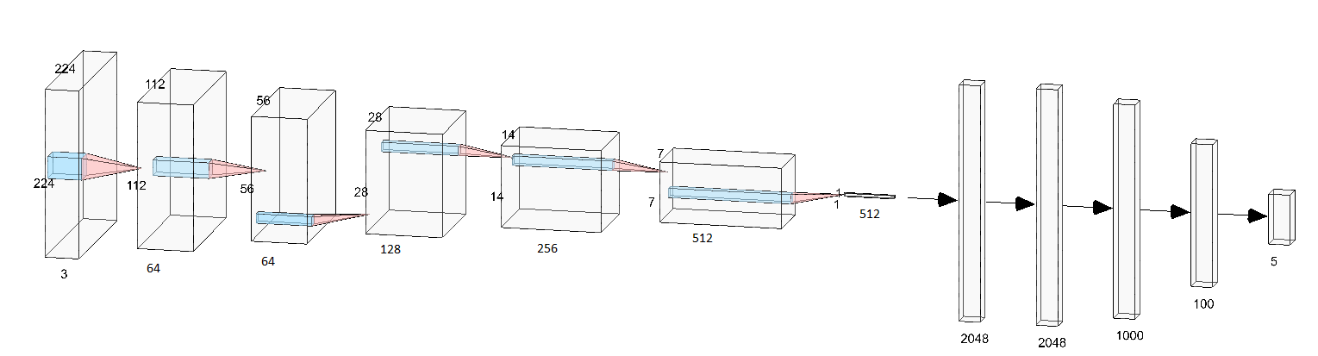
Model Architecture
ResNet is used for feature extracting,the updated layers are optimized
Regressing the 5 parameters x,y,h,w,θ
Notes:
Some approaches take mean of all ground truth – fails on cylic shapes
Some approaches tries to learn all of them sequentially

Slide 12
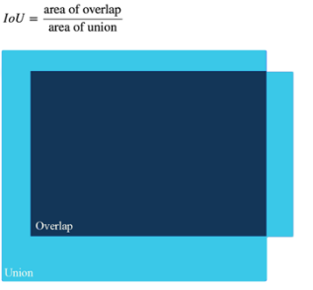
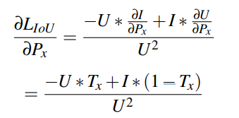
Loss Function
IoU is a better generalization for finding a grasping region than MSE.
We can use it for finding the closest annotation ( Remember the circular objects problem )
However, IoU is a non-differentiable operation, thus it is not commonly used in deep learning models.
Simplified form of IoU metric
Notes:
Why, key points of this project :
Since the area inside the grasping rectangle, is going to be the what grippers are directly interacting with
Area means more then L2 distance

Slide 13
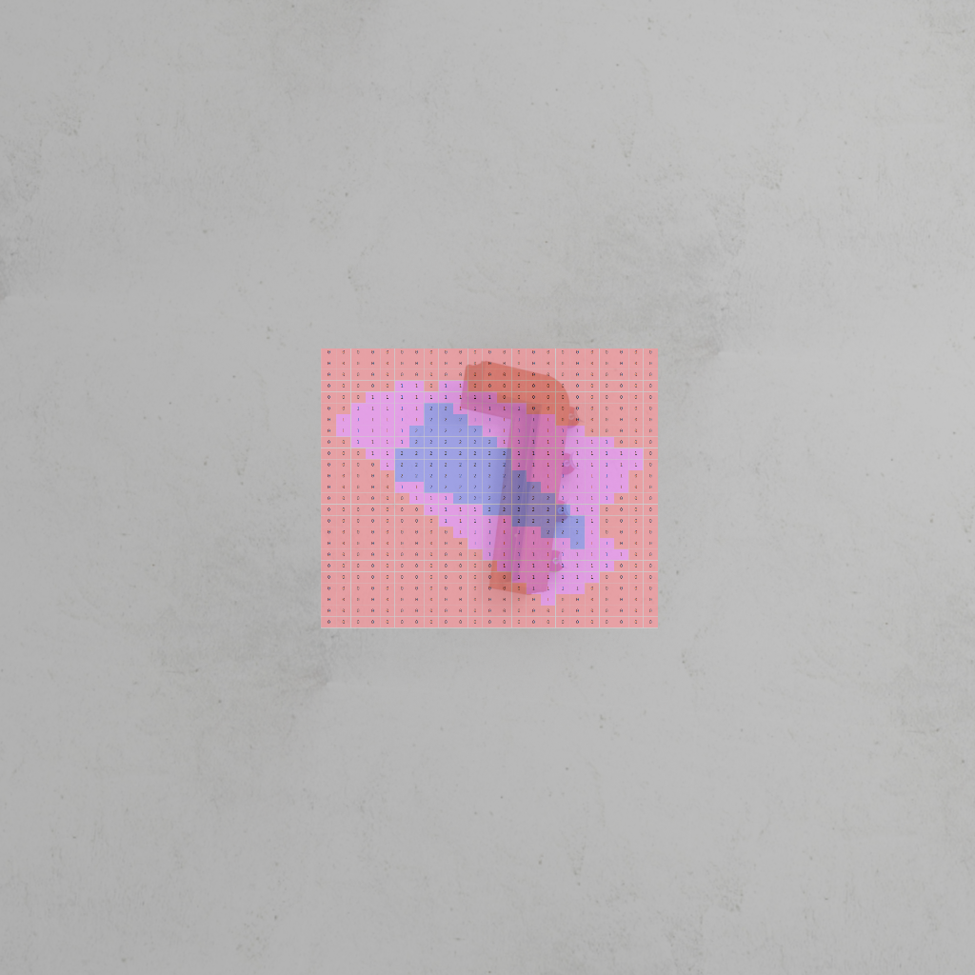
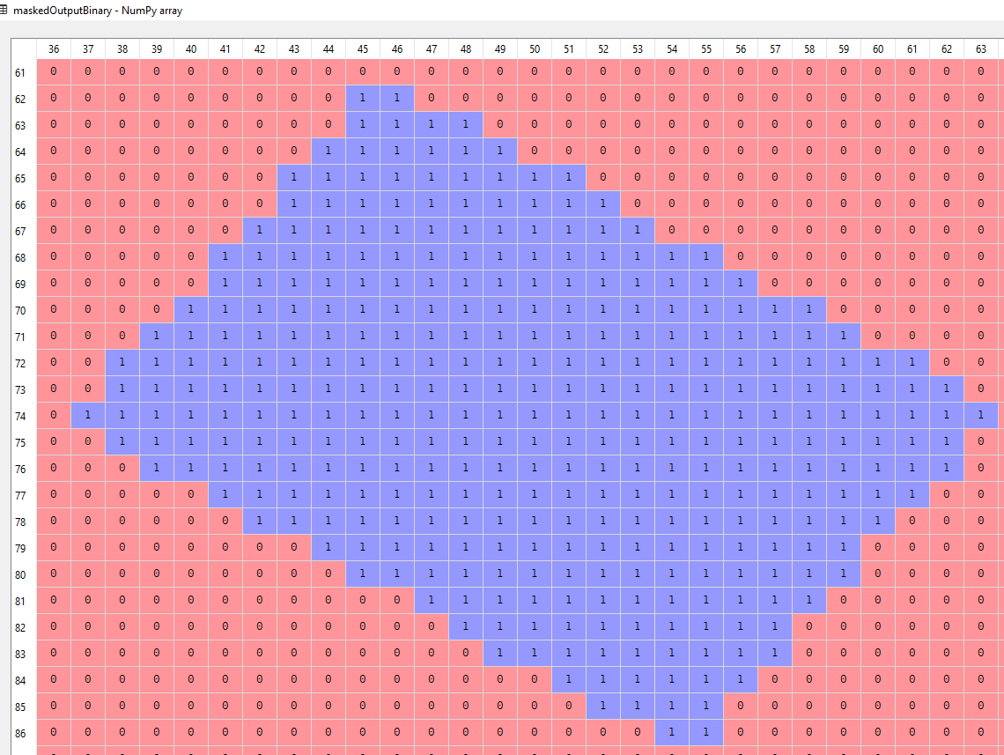
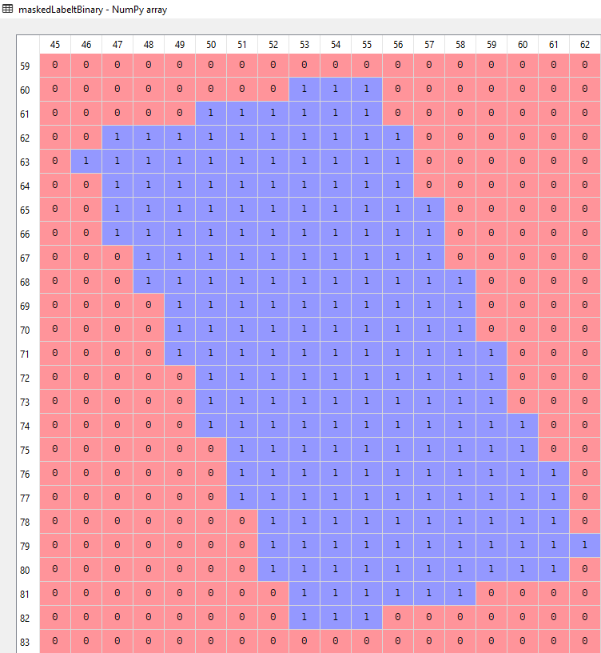
Masked Output
Making IoU Differentiable
Treating the problem as an image tranformation problem:
Create a custom mesh of nxn size
Apply affine transform for the pixels on the mesh according to the regression parameters.
Only the region within the grasping region will yield 1 while every other pixel is 0
Apply them to both label and output.
Subtraction of them gives intersection,addition of them gives union
IoU Map
Grasping trials for a tool object.
Masked Ground Truth

Slide 14
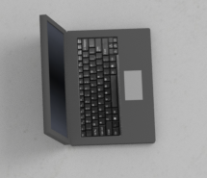
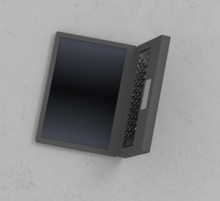
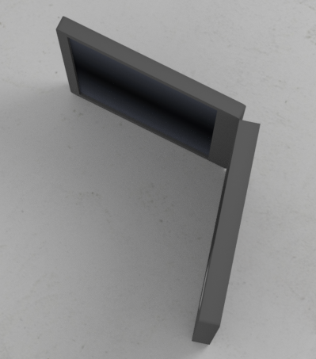
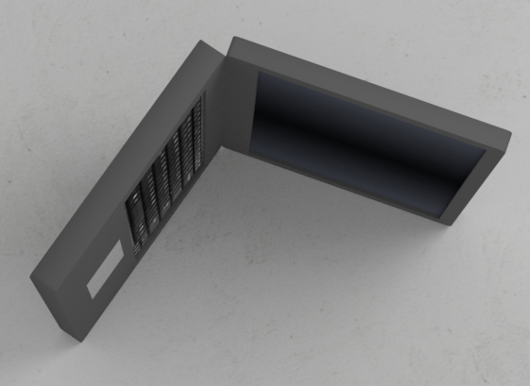
PRE-PROCESSING

Slide 16
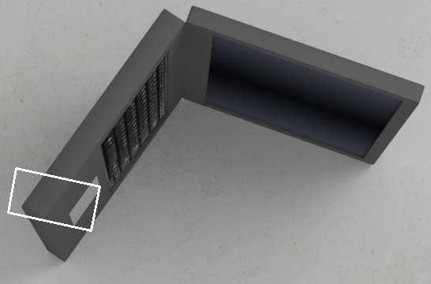
NETWORK
GROUND TRUTH VALUES

Slide 17
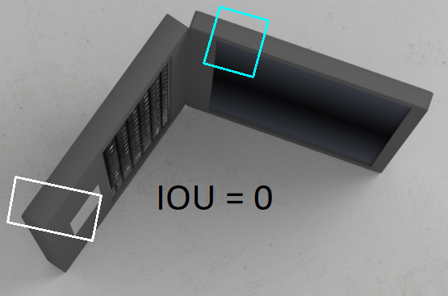
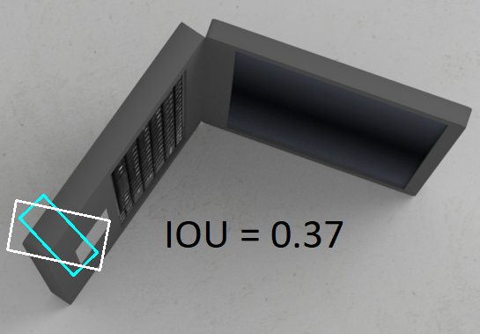
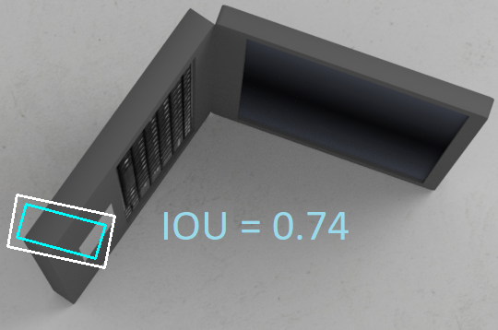
Closest annotation found!
White: Model output
Blue: Ground Truth Values

Slide 18
Contents
Motivation
Literature Review
Project
Results
Conclusion
Future Research Topics
References

Slide 19
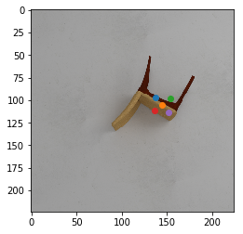
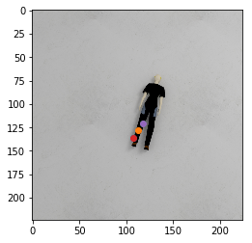
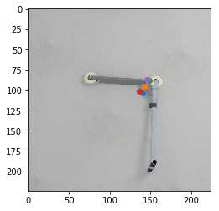
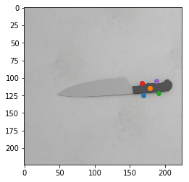
Results
250 Epochs
Over 1000 images
Pretrained ResNet/final layers updated
Orange points :grasping center other colors: gripper openings

Slide 20
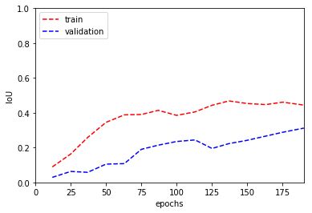
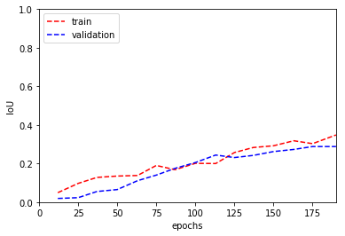
Results
Training and Validation errors are calculated w.r.t closest ground truth label
IoU outperforms the MSE
Trained with IoU
Trained with MSE

Slide 21
Contents
Motivation
Literature Review
Introduction
Project
Results
Conclusion
Future Research Topics
References

Slide 22
Conclusions
IoU Loss’ precision over L2 Norm, should be justified with testing
Tests should include
Simulation grasping trials with training data
Simulation grasping trials with novel data
Trials with Baxter, with novel data

Slide 23
Contents
Motivation
Literature Review
Introduction
Project
Results
Conclusion
Future Research Topics
References

Slide 24
Further Research Topics
Task-oriented Grasp Creation
Planning for different actions ( push, pour etc. )
Augmented method using heuristics with object detection
Notes:
In order to learn task-oriented grasps, you should design the training data and label them accordingly

Slide 25
Contents
Motivation
Literature Review
Introduction
Project
Results
Conclusion
Future Research Topics
References

Slide 26
References
[1]Y. Jiang, A. Saxena, Efficient Grasping from RGBD Images: Learning using a new Rectangle Representation
[2]L. Pinto and A. Gupta, "Supersizing self-supervision: Learning to grasp from 50K tries and 700 robot hours," 2016 IEEE International Conference on Robotics and Automation (ICRA), Stockholm, 2016, pp. 3406-3413.
[3] A. Saxena, Andrew Ng, Robotic Grasping of Novel Objects
[4] I. Lenz, H. Lee, and A. Saxena, “Deep learning for detecting robotic grasps,” The International Journal of Robotics Research, vol. 34, no. 4-5, pp. 705–724, 2015.
[5]J. Redmon and A. Angelova, "Real-time grasp detection using convolutional neural networks," 2015 IEEE International Conference on Robotics and Automation (ICRA), Seattle, WA, 2015, pp. 1316-1322.
[6]A. Depierre, E. Dellandrea, and L. Chen, “Jacquard: A Large Scale Dataset for Robotic Grasp Detection” in IEEE International Conference on Intelligent Robots and Systems, 2018 p.2 pp.4

